Slide 1

BLDEA's V P Dr PG Halakatti College of Engineering & TechnologY, VIJAYPURA
(Affiliated to Visvesvaraya Technological University)
PROJECT
on
Shopping Cart
(An application developed using Java)
Presented by: Under the Guidance of:
Rahul Patil Mr.Bheemesh Raghupathy
Amar Honwad

Slide 2
Acknowledgment
We the members of the group are highly grateful to
Mr. Bheemesh Raghupathy for his untiring help and encouragement during the course of project titled
“Shopping Cart” an application built using Java.
I highly acknowledge with deepest sense of gratitude and indebtedness, his great coordination and support
throughout the course of work
It is a great pleasure to present this report based on “Shopping Cart” undertaken by me as a part of my curriculum.

Slide 3
CONTENTS
S.NO | TITLE | PAGE.NO
1 | INTRODUCTION | 1
2 | RESEARCH AND METHODLOGY | 2
3 | HARDWARE AND SOFTWARE REQUIREMENTS | 3
4 | FLOWCHART | 4
5 | SOURCE CODE | 5-7
6 | OUTPUT | 8-9
7 | CONCLUSION | 10

Slide 4
INTRODUCTION
In today's fast-paced world, shopping has become an integral part of our daily lives. And with the help of technology, it has become a seamless and easy process. One of the essential aspects of shopping is generating a shopping bill, which provides a detailed summary of the purchased items and their respective prices. Now, imagine being able to create a shopping bill with just a few clicks! That's where Java programming language comes in.
Java is a powerful and versatile programming language that is widely used for developing desktop, mobile, and web applications. With its easy-to-understand syntax and robust libraries, Java can be an ideal choice for creating shopping bill software. In this project, we will leverage the power of Java to create a program that generates a comprehensive shopping bill for a customer.
Our program will take inputs from the user, including the number of items purchased, and the name and price of each item. It will then calculate the total cost of the purchase and generate a detailed bill for the customer. The program will be user-friendly, making the shopping experience hassle-free and enjoyable for the customer. With Java, we can create a shopping bill software that is both efficient and user-friendly, making the shopping experience a breeze for all.
1
1

Slide 5
research methodlogy
Combined with the Java language features, the paper proposed project-driven teaching model, and in-depth study of the mode of teaching the design principles and teaching of design and implementation.Java language is very popular object-oriented programming languages. Because of its many features are widely used in network programming.
In today's digital era, shopping has become a seamless and easy process with the help of technology. The process of generating a shopping bill can be automated using Java programming language. Java is a powerful programming language that is widely used for developing desktop, mobile and web applications. In this project, we will use Java to create a program that generates a shopping bill for a customer based on the items they have purchased and their respective prices. The program will take inputs from the user, calculate the total cost of the purchased items and generate a detailed bill for the customer.
2

Slide 6
Hardware and Software requirements:
1.Minimum Hardware Requirements
i. Monitor
ii. Keyboard
iii. Mouse4
2.Minimum Software Requirements
i. Operating System: Windows XP
ii. Eclipse IDE
3

Slide 7
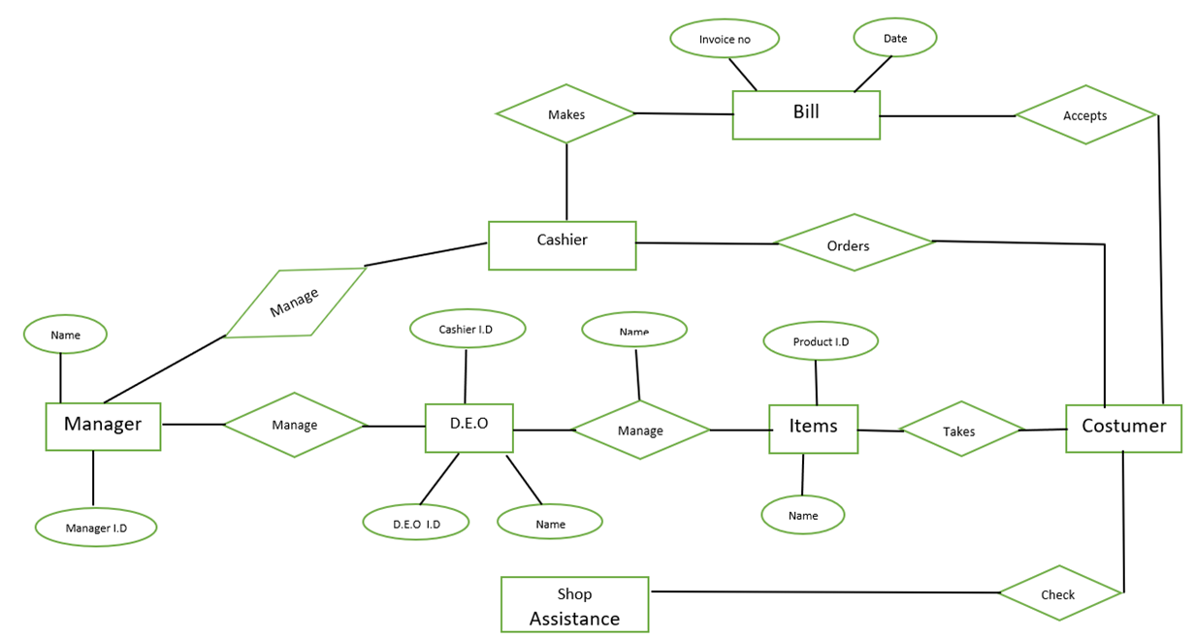
FLOWCHART
4

Slide 8
Source code:
package shopping;
import java.util.ArrayList;
import java.util.List;
import java.util.Scanner;
import java.text.SimpleDateFormat;
import java.util.Date;
import java.util.Calendar;
class Product
{
// properties
private String id;
private String pname;
private int qty;
private double price;
private double totalPrice;
// constructor
totalPrice)
Product(String id, String pname, int qty, double price, double
{
this.id=id;
this.pname = pname;
this.qty = qty;
this.price = price;
}
this.totalPrice = totalPrice;
// getter methods
public String getId()
{
return id;
}
public String getPname()
{
}
return pname;
public int getQty()
{
}
return qty;
public double getPrice()
{
}
return price;
public double getTotalPrice()
{
}
return totalPrice;
//displayFormat
public static void displayFormat()
{
System.out.format("-----------------------------------
--------------------------------------------------------------------------
----------------------");
5

Slide 9
System.out.print("\nProduct ID
\t\tName\t\tQuantity\t\tRate \t\t\t\tTotal Price\n");
System.out.format("-----------------------------------
--------------------------------------------------------------------------
----------------------\n");
}
// display
public void display()
{
%9.2f
}
System.out.format(" %-9s
%-9s
%5d
}
%14.2f\n" ,id, pname, qty, price, totalPrice);
public class ShoppingBill
{
public static void main(String args[])
{
// variables
String id = null;
String productName = null;
int quantity = 0;
double price = 0.0;
double totalPrice = 0.0;
double overAllPrice = 0.0;
double cgst, sgst, subtotal=0.0, discount=0.0;
char choice = '\0';
System.out.println("\t\t\t\t--------------------Invoice---
--------------");
System.out.println("\t\t\t\t\t "+" "+"5 STAR
COLLECTIONS");
System.out.println("\t\t\t\t\t GANDHI CHOWK,VIJAYPURA");
System.out.println("GSTIN:
03AWBPP8756K592"+"\t\t\t\t\t\t\tContact: (+91) 8988776655");
//format of date and time
SimpleDateFormat formatter = new
SimpleDateFormat("dd/MM/yyyy HH:mm:ss");
Date date = new Date();
Calendar calendar = Calendar.getInstance();
String[] days = new String[] { "Sunday", "Monday",
"Tuesday", "Wednesday", "Thursday", "Friday", "Saturday" };
//prints current date and time
System.out.println("Date: "+formatter.format(date)+"
"+days[calendar.get(Calendar.DAY_OF_WEEK) - 1]+"\t\t\t\t\t\t (+91)
9998887770");
Scanner scan = new Scanner(System.in);
System.out.print("Enter Customer Name: ");
String customername=scan.nextLine();
//create Scanner class object
//creating an ArrayList to store the product
List<Product> product = new ArrayList<Product>();
do
{
// read input values
6

Slide 10
System.out.println("Enter the product details: ");
System.out.print("Product ID: ");
id = scan.nextLine();
System.out.print("Product Name: ");
productName = scan.nextLine();
System.out.print("Quantity: ");
quantity = scan.nextInt();
System.out.print("Price (per unit): ");
price = scan.nextDouble();
//calculate total price for a particular product
totalPrice = price * quantity;
//calculates overall price
overAllPrice = overAllPrice + totalPrice;
//creates Product class object and add it to the
List
product.add( new Product(id, productName,
quantity, price, totalPrice) );
// ask for continue shopping?
n): ");
System.out.print("Want to add more items? (y or
//reads a character Y or N
choice = scan.next().charAt(0);
//read remaining characters, don't store (no use)
scan.nextLine();
}
while (choice == 'y' || choice == 'Y');
//display all product with its properties
Product.displayFormat();
for (Product p : product)
{
p.display();
}
//price calculation
System.out.println("\n\t\t\t\t\t\t\t\t\t\tTotal Amount
(Rs.) " +overAllPrice);
//calculating discount
discount = overAllPrice*2/100;
(Rs.) " +discount);
System.out.println("\n\t\t\t\t\t\t\t\t\t\t
Discount
//total amount after discount
subtotal = overAllPrice-discount;
System.out.println("\n\t\t\t\t\t\t\t\t\t\t
Subtotal "+subtotal);
//calculating tax
sgst=overAllPrice*12/100;
(%) "+sgst);
(%) "+cgst);
System.out.println("\n\t\t\t\t\t\t\t\t\t\t
SGST
cgst=overAllPrice*12/100;
System.out.println("\n\t\t\t\t\t\t\t\t\t\t
CGST
//calculating amount to be paid by buyer
System.out.println("\n\t\t\t\t\t\t\t\t\t\t
Invoice
Total " +(subtotal+cgst+sgst));
7

Slide 11
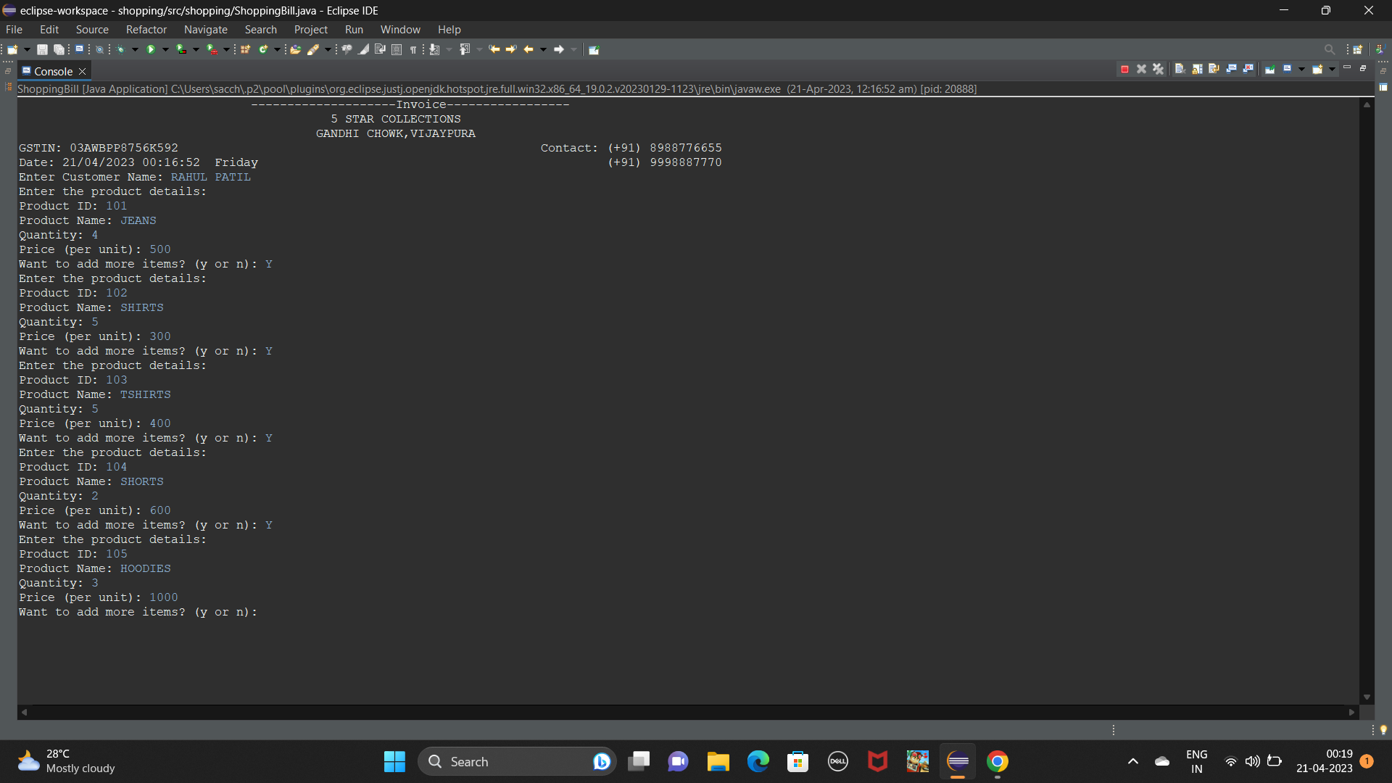
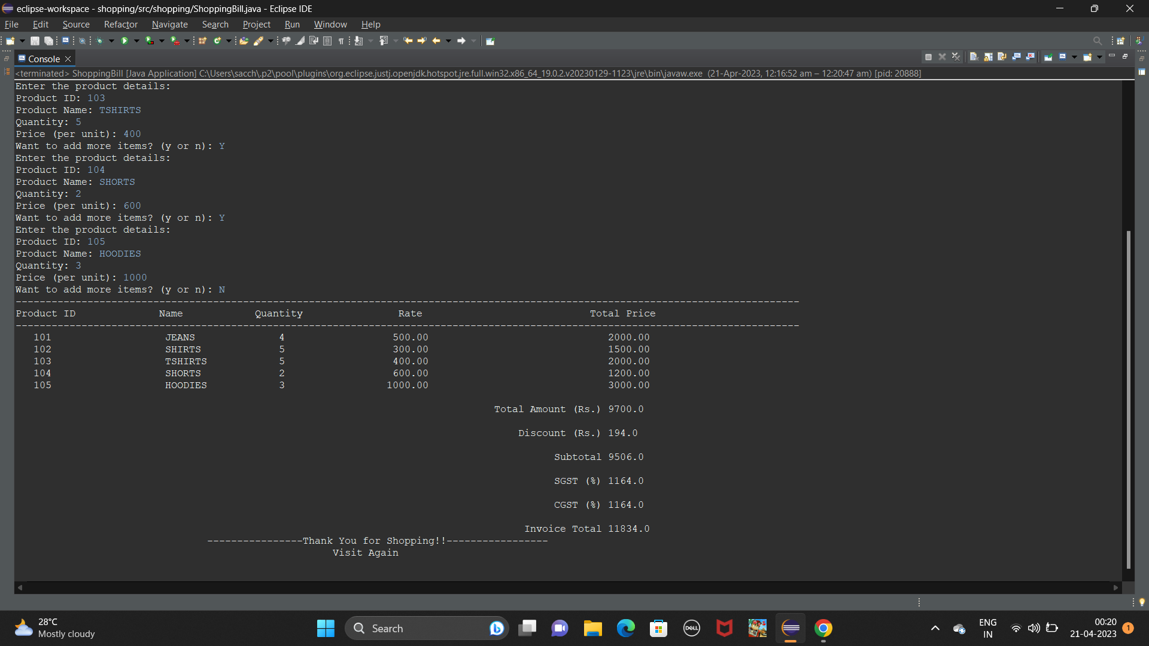
System.out.println("\t\t\t\t----------------Thank You for
Shopping!!-----------------");
System.out.println("\t\t\t\t
Again");
Visit
// close Scanner
scan.close();
}
}
OUTPUT:
8

Slide 12
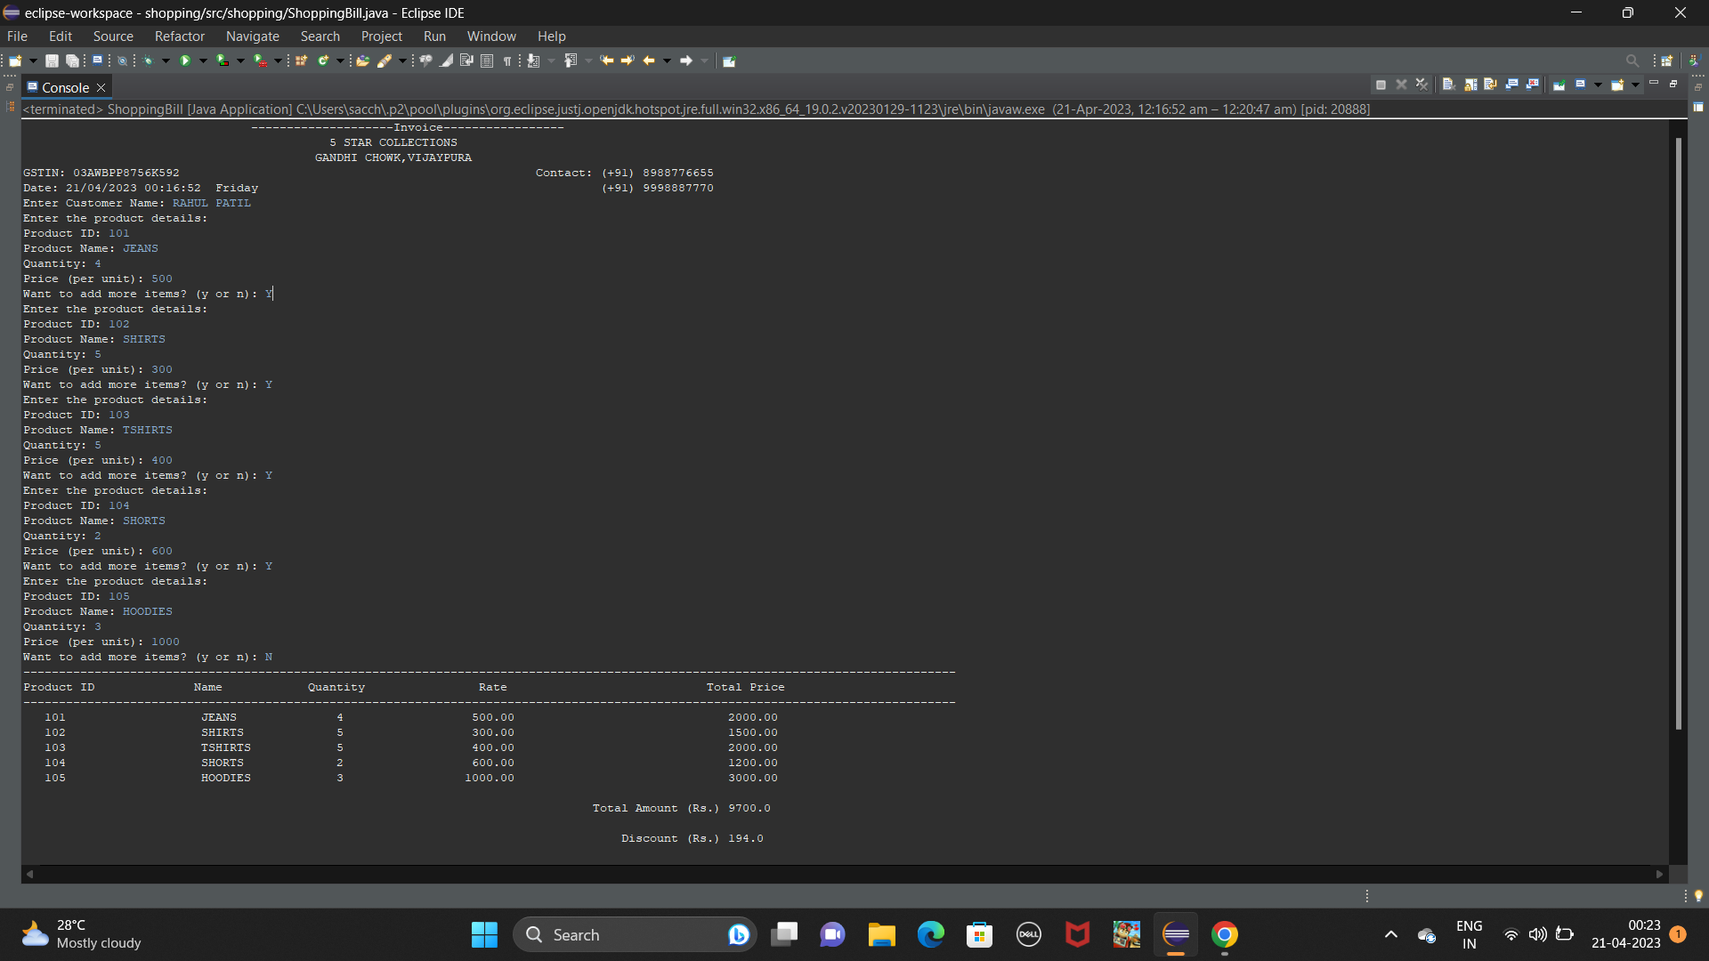
9

Slide 13
CONCLUSION
Overall, the conclusion would provide an evaluation of the success of the project, considering factors such as usability, functionality, and user experience. It would also discuss any potential areas for further development or improvements.
In conclusion, a Shopping cart application using Java programming can be a challenging but rewarding project. By using Java programming, developers can create a powerful and flexible application that can provide a fun and engaging experience for users. However, it requires careful planning, development, and testing to ensure that the application is functional, reliable, and user-friendly.
10

